Slide 1
Northeastern University
Application Engineering Development, Spring 2021
Shiva Shankar Ananthula 001549845
Koushik Kumar Karre 001568820
Deepika Reddy Chudi 001593148
Assignment 3: University Model
Implementation

Slide 2
University Model
Objective:
Quality of Education plays a crucial role for a university to maintain its reputation. To maintain the standards software engineering techniques are used to keep track of their quality standards. The feedback from alumni and employer is taken into consideration to collect the courses that contributed for their growth in the 5 year span.

Slide 3
Computation of Feedback for the Faculty.
To compute the Feedback for the faculty, it would be better if we design a model where each student can report their review for the faculty in their respective seat assignment of the CourseOffer.
Hence, we enable an option from a student to report the faculty feedback to all the course offers he registered in his transcript.
After, the student providing the feedback to the professor, now our aim is to calculate overall review for the respective course.
For individual faculty, for each course he teaches, we can aggregate all the student feedback given in the respective course.

Slide 4
Code Snippet for faculty feedback:
public double getFacultyReviewAcrossCourses(){ double aggregate=0.0; int counter =0; for(FacultyAssignment fa: this.facultyassignments){ aggregate += fa.getFacultyFeedback(); counter++; } return aggregate/counter; }

Slide 5
CGPA for Student:
In our model, we enable the faculty in the particular course offer to grade each individual seat assignment.
In the similar way, all the faculties' grades to their respective seat assignments.
Now at a student level, we can aggregate all the grades provided by the faculty to the registered courses of the student across all the semesters to calculate the CGPA.

Slide 6
Code Snippet for calculating CGPA:
public double CalculateGPA(){ double aggregateGrade =0.0; int counter=0; for(CourseLoad cl: this.courseloadlist.values()){ for(SeatAssignment sa: cl.getSeatassignments()){ aggregateGrade += sa.Grade; counter++; } } return aggregateGrade/counter; }

Slide 7
How to improve the quality of education by keeping up with the industry trends.
In order to model this requirement, what we could do is that, among all the employments taken by the Students across the departments over all the colleges, we calculate the job(employment) which has more growth in the company by calculating the promotions.
Later after getting the top 10 more popular jobs, what we could do is aggregating all the relevant courses for those respective jobs and the colleges can try to add those courses in their curriculum for the upcoming semesters.
With this type of modeling, every college can try to research the best important course for the prominent jobs and keep those courses fresh.

Slide 8
Track the jobs and Promotions Students get
In order to model the jobs and promotions, we can have a Employment(SDE,QA) class which has reference to both Student and the Employer(Google,Facebook).
A student can have an arraylist of all the employments that he had been part of for the past 5 years.
At an Employment level, we can have properties like the Number of Promotions he got at the particular employment.
Hence for every new job, a student acquires, we can add the new Employment to the EmploymentHistory of the Student. Or whenever a student gets a promotion, we can add the promotions to the current employment.

Slide 9
Ranking the students based on the promotions.
The below code depicts the logic for computing the Ranks for the students based on their promotions.
public HashMap<StudentProfile,Integer> RankStudentsBasedOnPromotions(){ HashMap<StudentProfile,Integer> StudentToPromotions = new HashMap<StudentProfile, Integer>(); for(StudentProfile sp: this.studentlist){ int count=0; for(Employment emp : sp.employmenthistory.getEmployments()){ count+= emp.getPromotions(); } StudentToPromotions.put(sp, count); } List<Map.Entry<StudentProfile,Integer>> list = new LinkedList<Map.Entry<StudentProfile,Integer>>(StudentToPromotions.entrySet()); Collections.sort(list, new Comparator<Map.Entry<StudentProfile, Integer> >() { public int compare(Map.Entry<StudentProfile, Integer> o1, Map.Entry<StudentProfile, Integer> o2) { return (o1.getValue()).compareTo(o2.getValue()); } }); HashMap<StudentProfile, Integer> temp = new LinkedHashMap<StudentProfile, Integer>(); for (Map.Entry<StudentProfile, Integer> aa : list) { temp.put(aa.getKey(), aa.getValue()); } return temp; }

Slide 10
Ranking the Students based on GPA
To compute the Ranking for the students among the Department, we could compute the CGPA for each student in the department and rank them accordingly.

Slide 11
Computing the most Popular course
There are two ways of computing the most popular course in a department.
One way to computing the popular course is across all the semesters for the department, we can aggregate the number of seats occupied for each Course across all the CourseOffers for that particular course and extract the Course which was occupied by more students.
In this way, we just get the Course just based on the occupancy, but not based on the number of jobs students are getting after the graduation.

Slide 12
Relevance of Courses to Graduate Growth
One of the important feature to be implemented for the universities is to calculate the Courses that are having a major impact for the graduate growth.
In order to compute this, what we could propose is that, we can rank the courses based on the number of Students who are succeeding at their respective employments in the form of the increments and promotions they are being offered.

Slide 13
The code snippet for compute the Relevance of the Courses is as below
public HashMap<Course, Integer> getMostPopularCourse(){
HashMap<Course,Integer> CourseToPromotions = new HashMap<Course, Integer>(); for(Map.Entry entry: this.mastercoursecatalog.entrySet()){ CourseSchedule cs = (CourseSchedule)entry.getValue(); for(CourseOffer co: cs.getSchedule()){ int promotions =0; for(Seat s: co.getSeatlist()){ if(s.getSeatassignment()!=null){ promotions += s.getSeatassignment().getCourseload().getTranscript().getStudentProfile().GetNumberOfPromotions(); } } CourseToPromotions.put(co.getCourse(), promotions); } } List<Map.Entry<Course,Integer>> sortedCourseList = new LinkedList<Map.Entry<Course,Integer>>(CourseToPromotions.entrySet()); Collections.sort(sortedCourseList, new Comparator<Map.Entry<Course, Integer> >() { public int compare(Map.Entry<Course, Integer> o1, Map.Entry<Course, Integer> o2) { return (o1.getValue()).compareTo(o2.getValue()); } });
HashMap<Course, Integer> temp = new LinkedHashMap<Course, Integer>(); for (Map.Entry<Course, Integer> aa : sortedCourseList) { temp.put(aa.getKey(), aa.getValue()); } return temp; }

Slide 14
Relation between GPA and industrial Success.
In our university model, it is easy to establish a relation between Student GPA and Industrial success.
At a student level, we have access to the all the Employment related data.
Hence for every student, we can check if the student with a substantial career path has high GPA or not.
With this we calculate the statistical data for all the students and determine if the CGPA is affecting to the industrial growth.

Slide 15
Ranking the institutions based on the the industrial growth.
Similar to the previous ways, we can aggregate the Student growth for each institution and rank them accordingly.

Slide 16
Computing the Quality of education the institution has provided.
We can compute the quality of the education provided by university based on the courses the college is offering.
The courses offered are matched with the industry trends which are calculated by the number of students who have taken courses and are successful in that particular field.

Slide 17
Ranking system of educational institute
A college in a university are ranked based on the number of promotions students are receiving.
A college/department is advanced if the students are successful in their career paths.
With improvement in student’s career indicates the college curriculum has matched the industry standards.

Slide 18
Creation and updating the University Model
In our model, we are enabling the option to keep the model up to date for which Update and Create options are available.
We can add Student and update student details
To keep with technical advancement, we can add Courses and update them.
If a faculty no longer wants to teach or retired, we can replace the faculty with another professor.

Slide 19
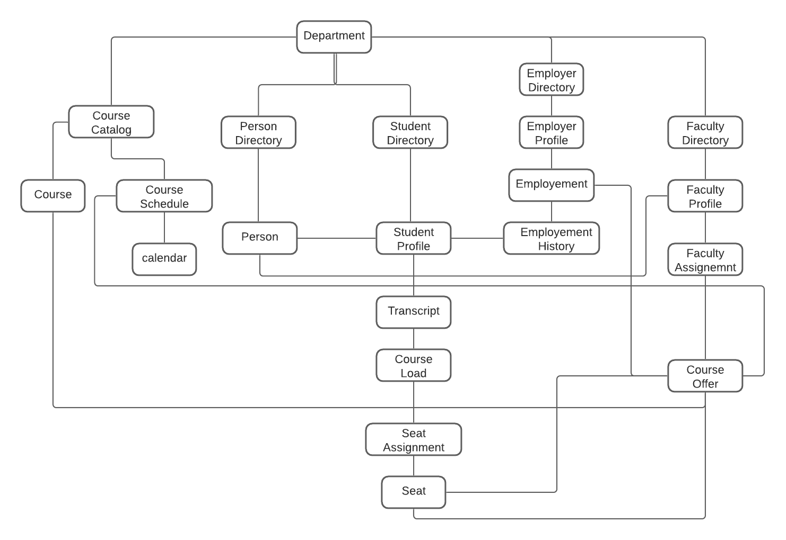
Object Model

Slide 20
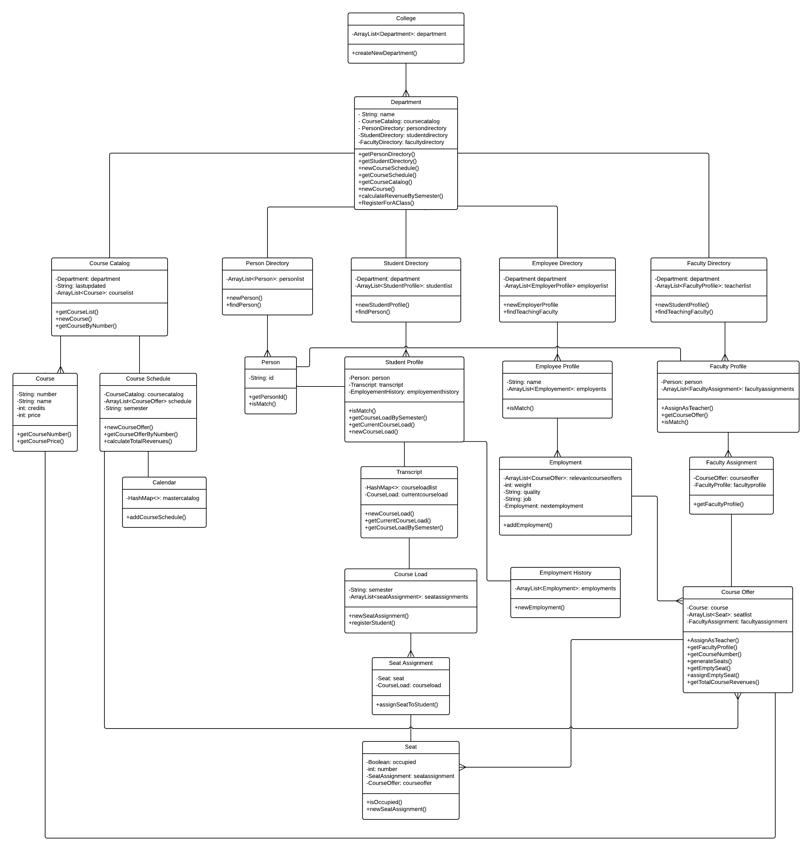

Slide 21
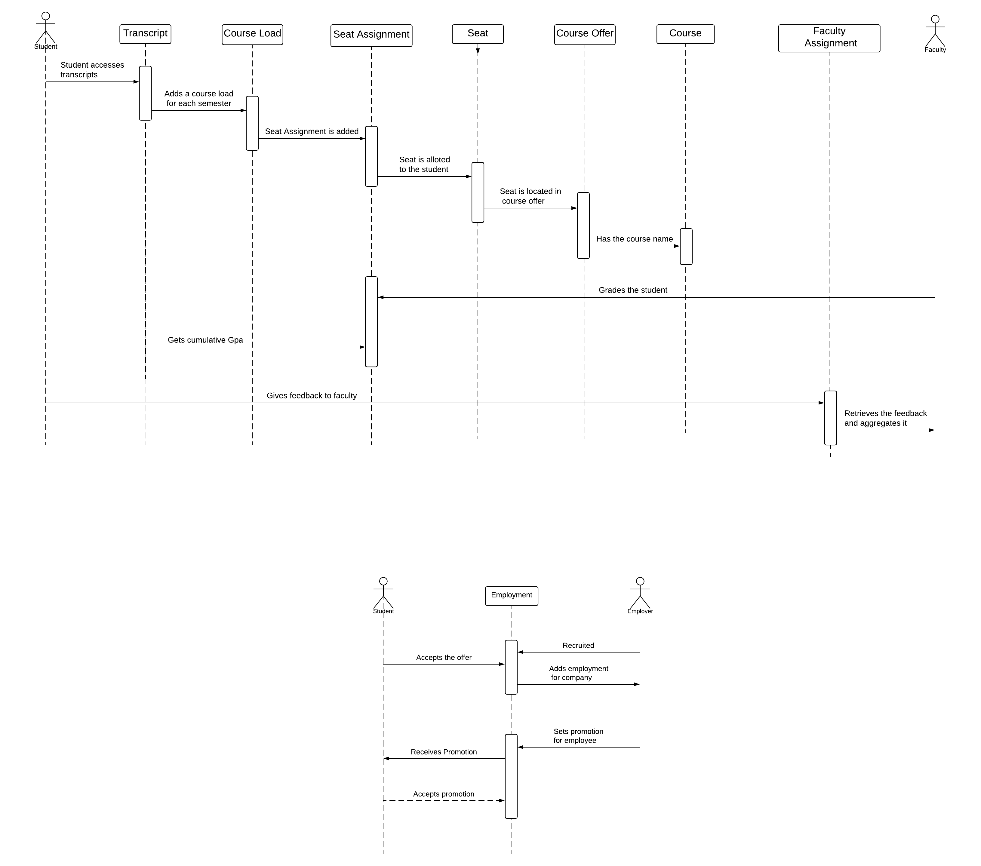
Sequence Diagram

Slide 22
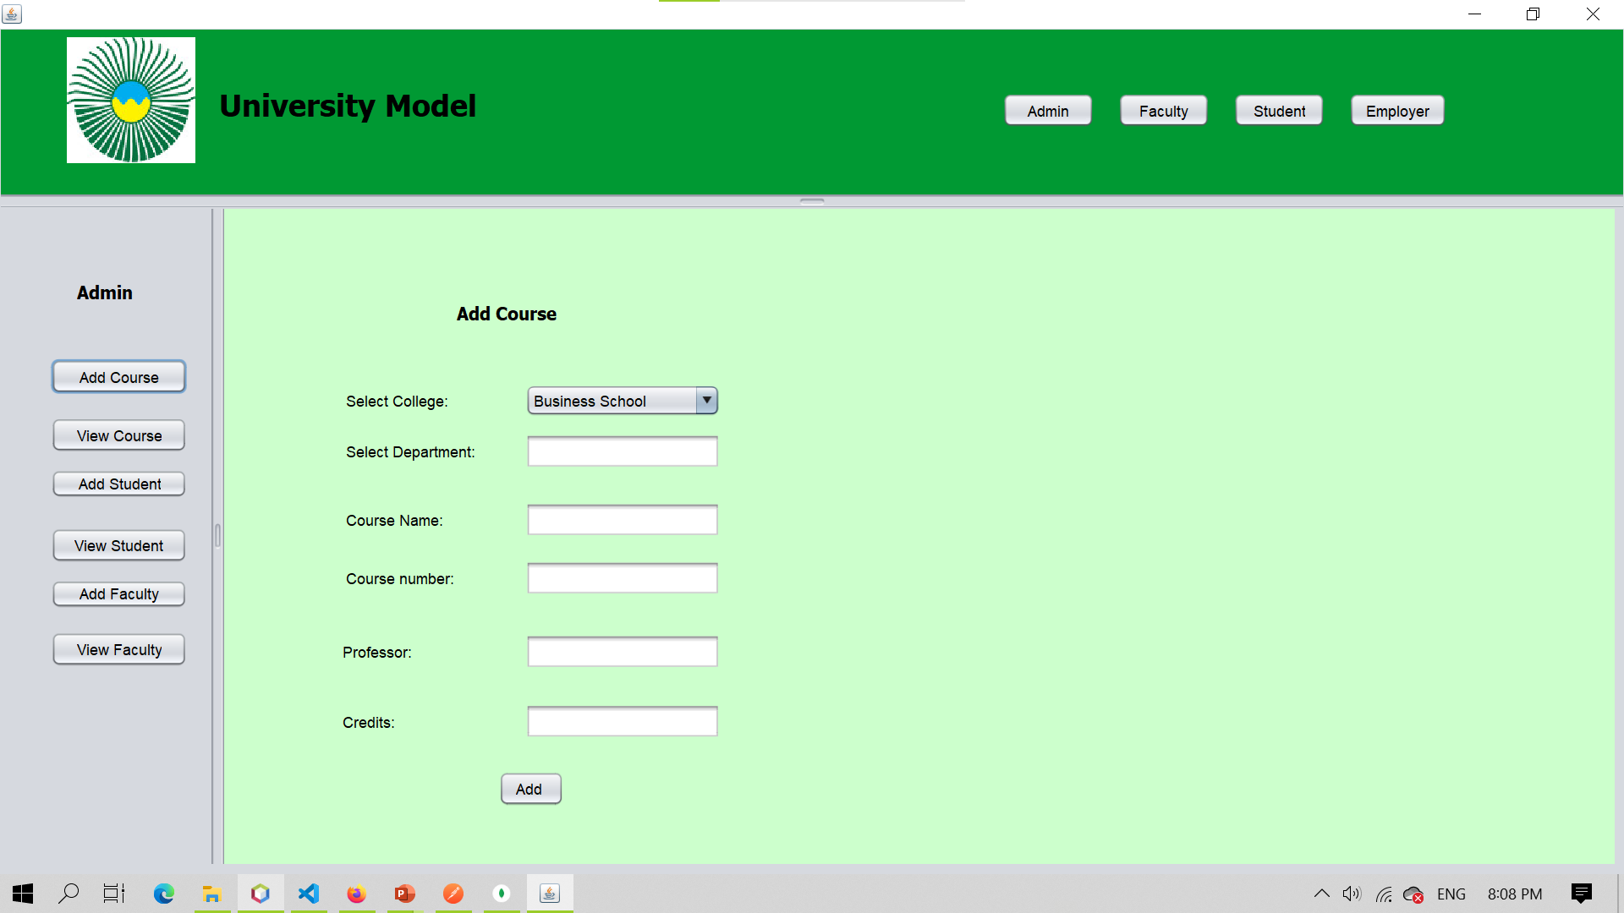

Slide 23
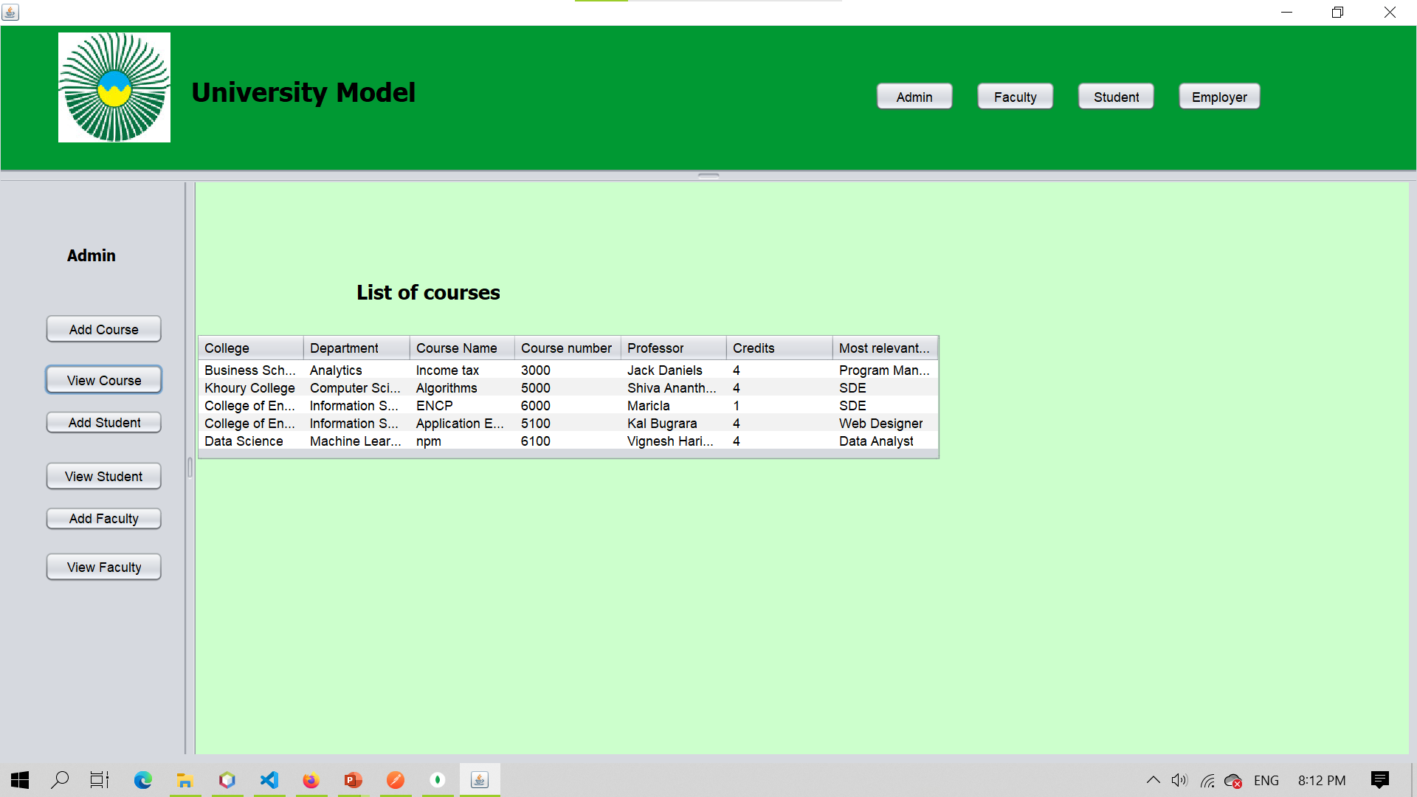

Slide 24
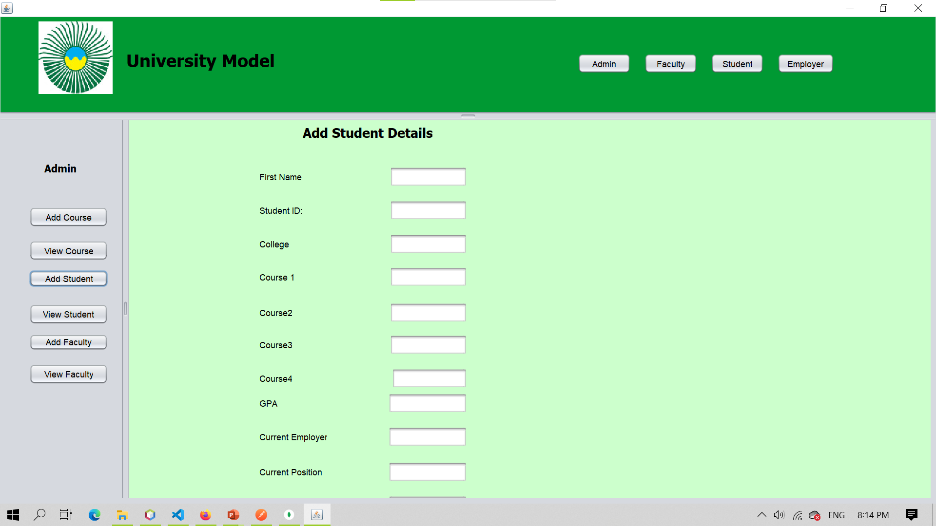

Slide 25
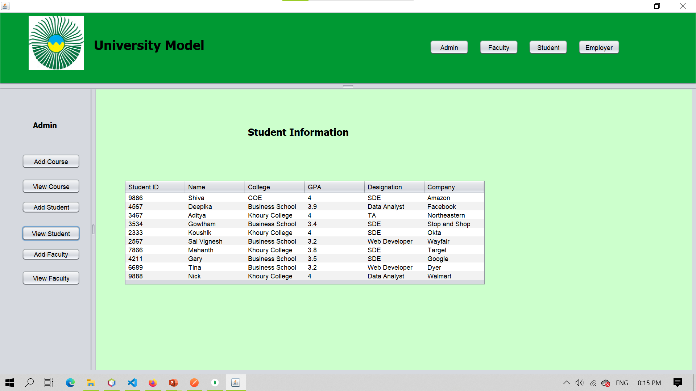

Slide 26
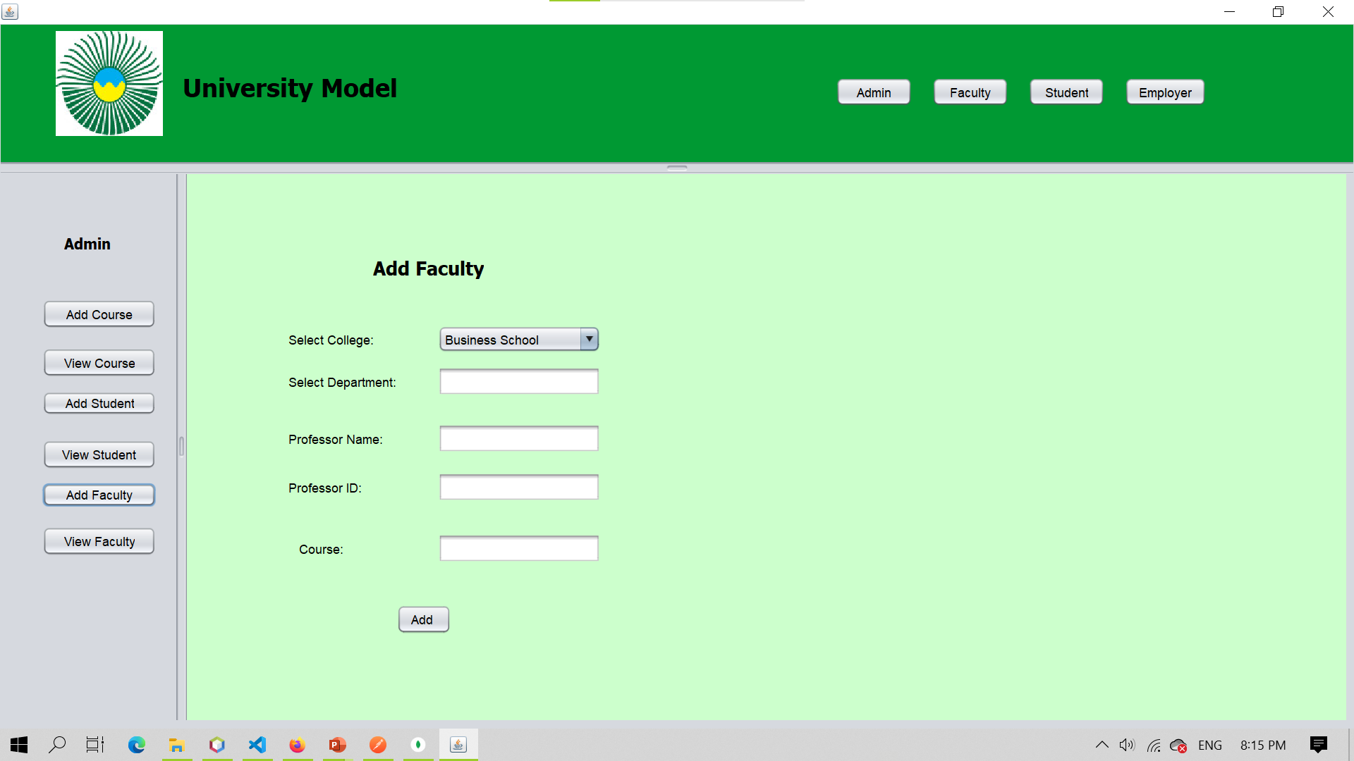

Slide 27
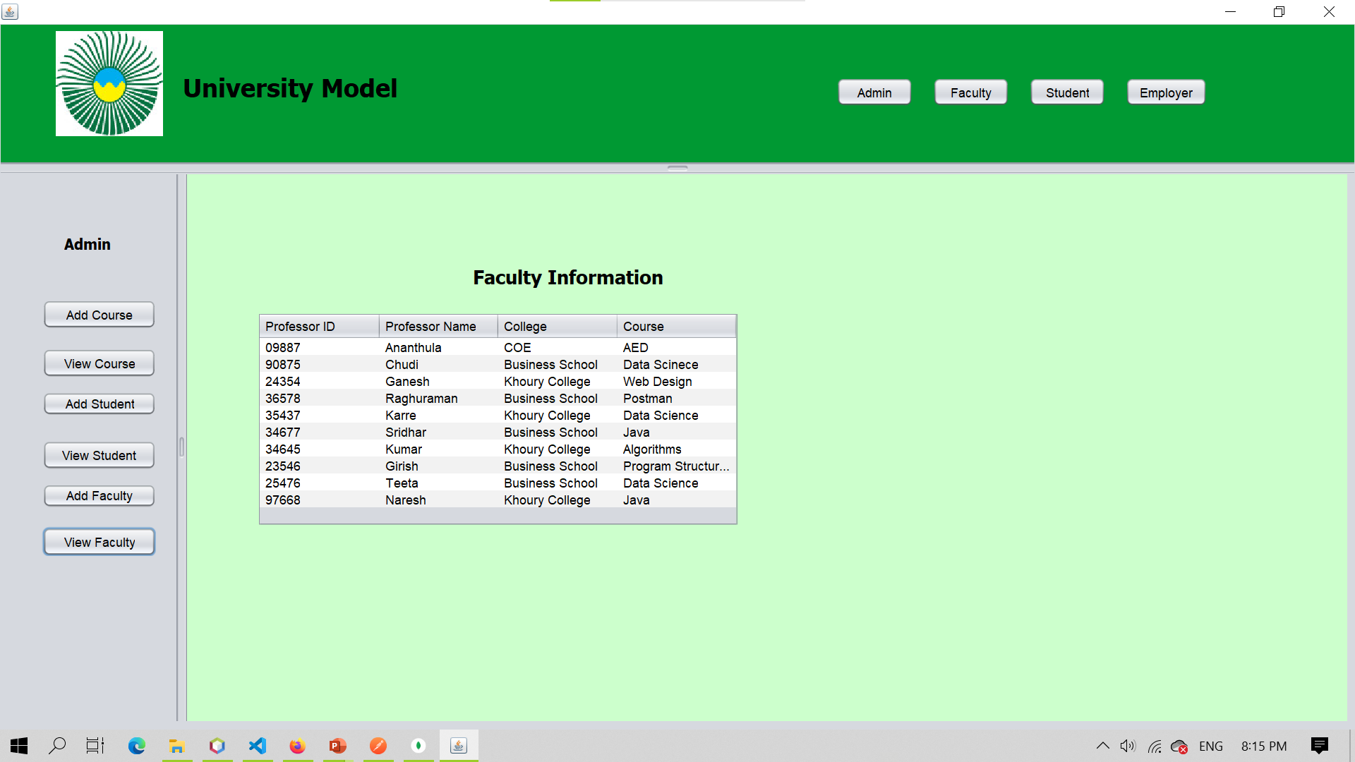

Slide 29
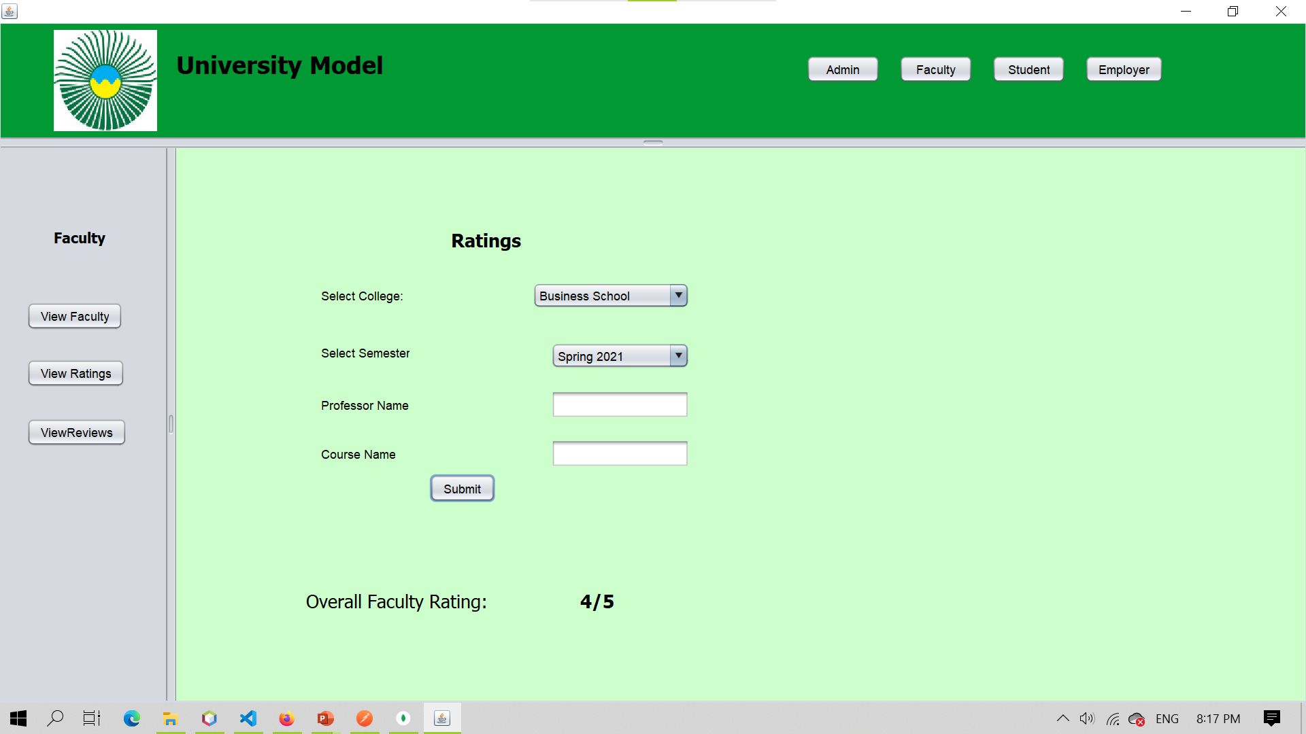

Slide 30
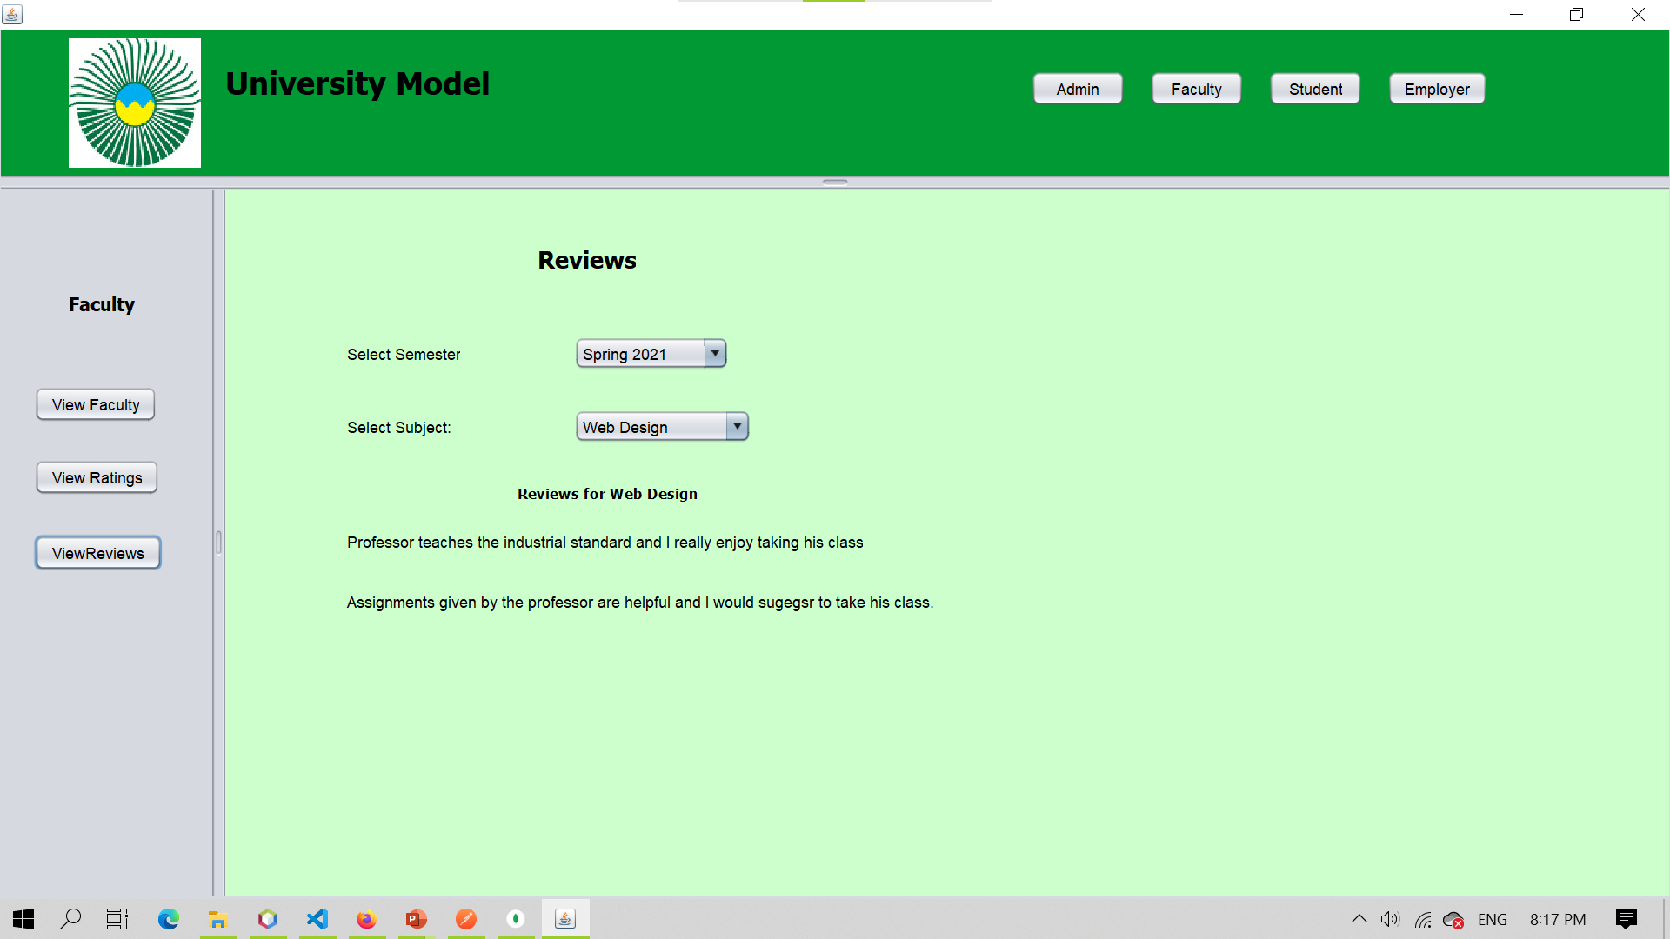

Slide 31
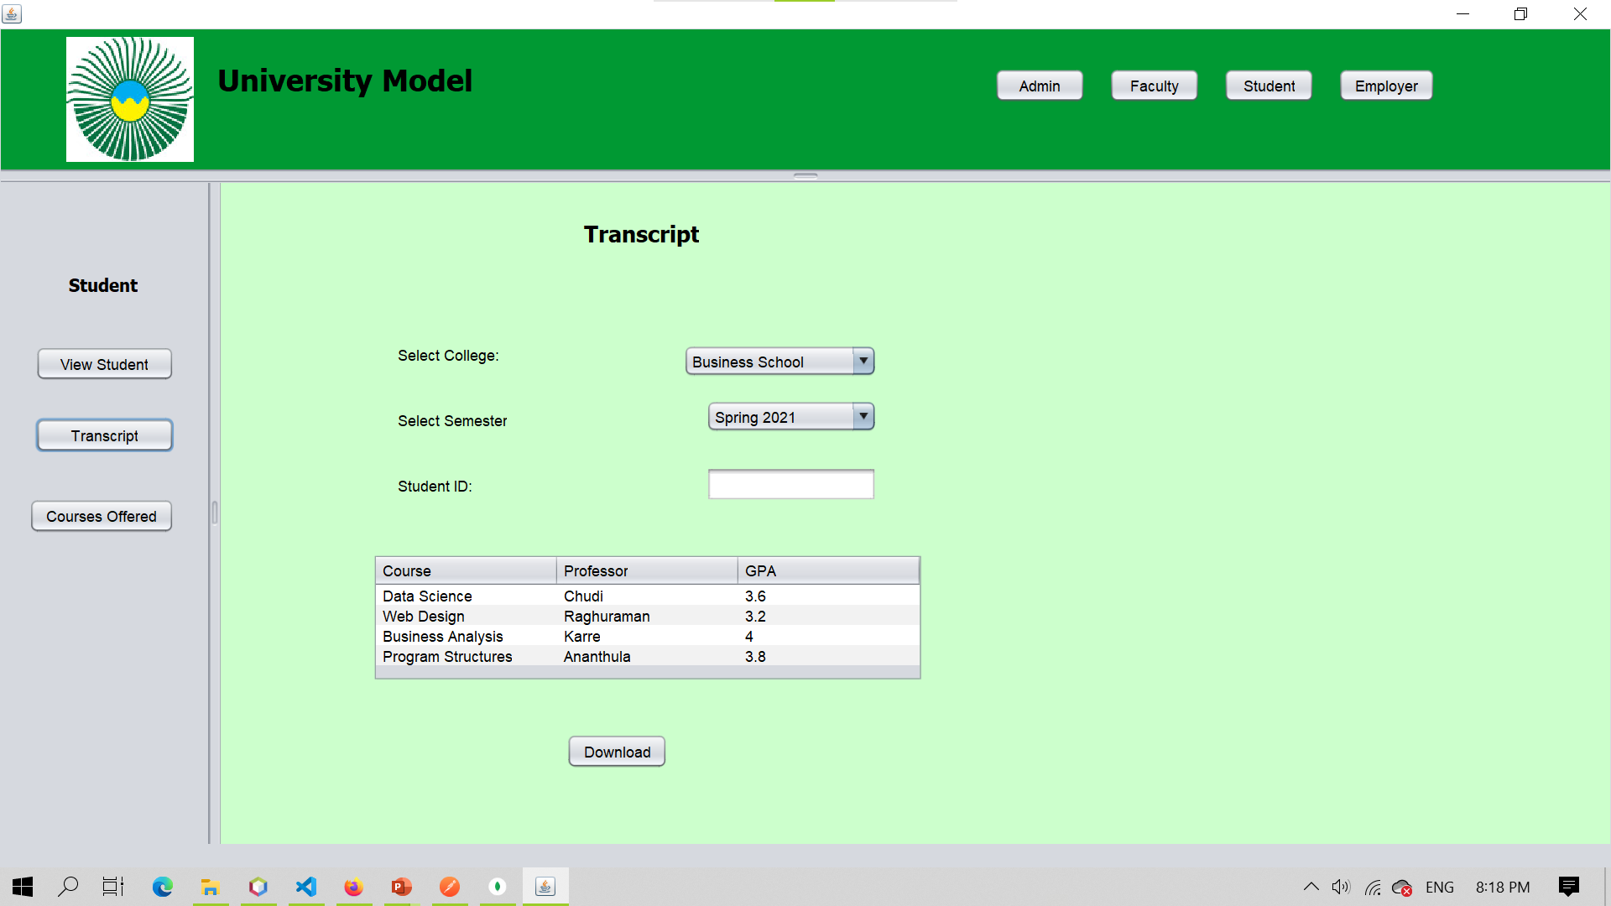

Slide 32
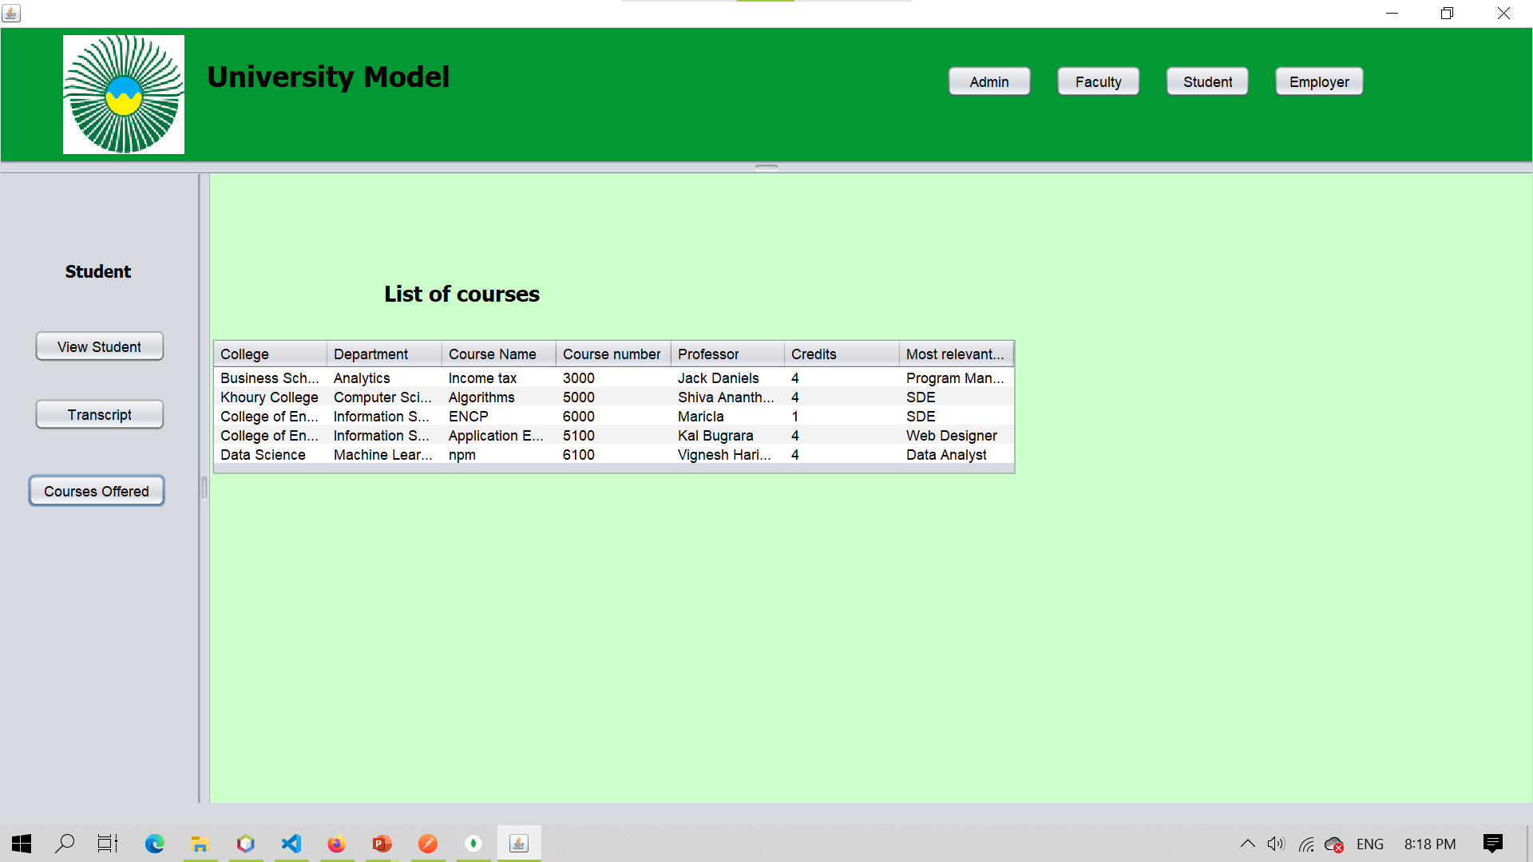

Slide 33
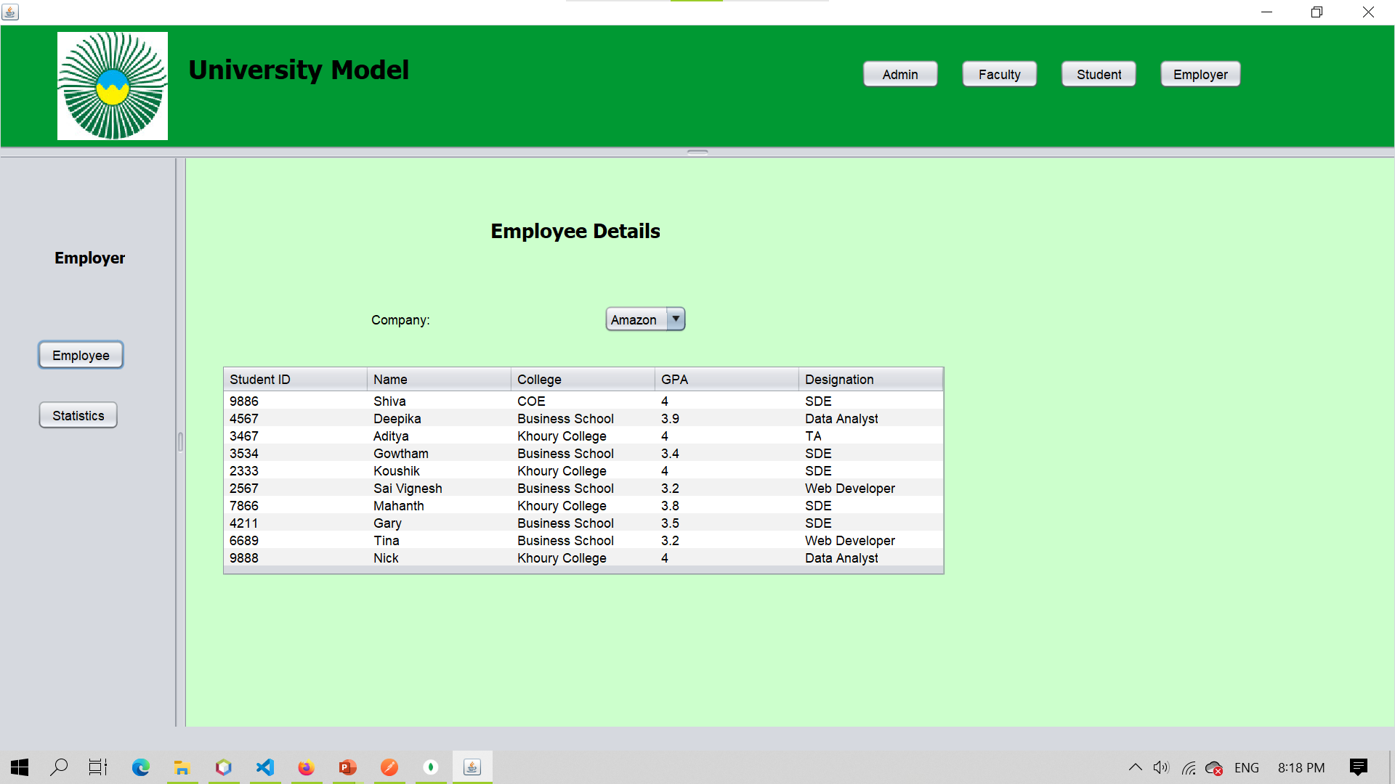

Slide 34
